Slide 1
Excess Burden, Applied
Chicago Price Theory

Slide 2
Applications of Excess Burden
Regulatory analysis
Laffer curve
The case for broad-based taxation
The case against broad-based taxation
Theories of political economy
Adaptation to climate change
The costs of crime
The costs of disease

Slide 3

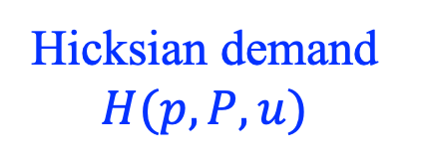


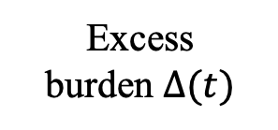

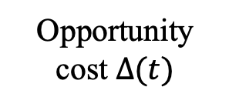

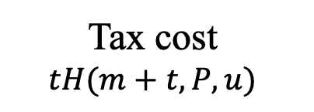
Figure 1. Areas under a Hicksian demand curve
p
Hicksian demand $H(p,P,u)$
A
$$m+t$$
$$tH\left(m+t,P,u\right)≤$$
$$c\left(m+t,P,u\right)−c\left(m,P,u\right)≤$$
$$tH(m,P,u)$$
Tax cost
$$tH(m+t,P,u)$$
Opportunity cost $Δ(t)$
Excess
burden $Δ(t)$
B
Marginal cost
$$m$$
Quantity of taxed good
0
$$H(m+t,P,u)$$
$$H(m,P,u)$$

Slide 4
Figure 1. Areas under a Hicksian demand curve
p
Hicksian demand $H(p,P,u)$
Vertical area =
value of foregone taxed good
= Additional spending on other goods needed to maintain utility
A
$$m+t$$
Excess
burden $Δ(t)$
B
Marginal cost
$$m$$
Quantity of taxed good
0
$$H(m+t,P,u)$$
$$H(m,P,u)$$

Slide 5
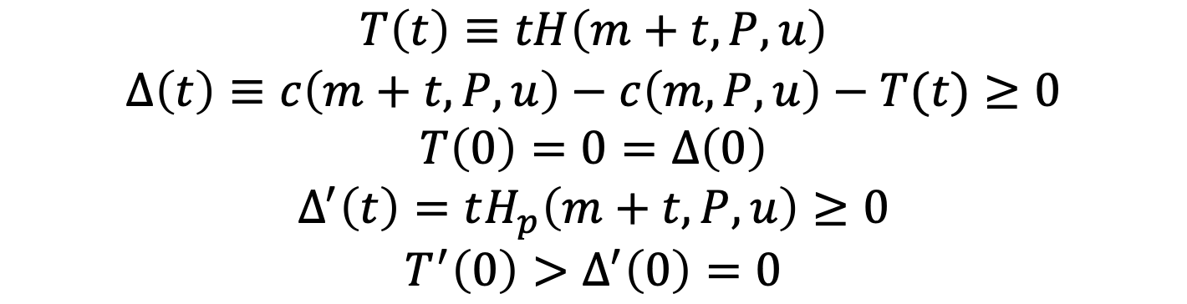
Properties of Excess Burden
$$T\left(t\right)≡tH\left(m+t,P,u\right)$$
$$Δ\left(t\right)≡c\left(m+t,P,u\right)−c\left(m,P,u\right)−T(t)≥0$$
$$T\left(0\right)=0=Δ\left(0\right)$$
$$Δ^{′}\left(t\right)=tH_{p}\left(m+t,P,u\right)≥0$$
$$T^{′}\left(0\right)>Δ^{′}\left(0\right)=0$$
A nonzero tax has a tax cost and an opportunity cost
For small tax rates, the tax cost dominates; the excess burden is negligible
  Part of the case against central planning
  Volunteer vs. conscripted army

Slide 6
Figure 1. Areas under a Hicksian demand curve
p
High-value units remain on the market
A
$$m+t$$
B
Marginal cost
$$m$$
Quantity of taxed good
0
$$H(m+t,P,u)$$
$$H(m,P,u)$$

Slide 7

Properties of Excess Burden
$$T\left(t\right)≡tH\left(m+t,P,u\right)$$
$$Δ\left(t\right)≡c\left(m+t,P,u\right)−c\left(m,P,u\right)−T(t)≥0$$
$$T\left(0\right)=0=Δ\left(0\right)$$
$$Δ^{′}\left(t\right)=tH_{p}\left(m+t,P,u\right)≥0$$
$$T^{′}\left(0\right)>Δ^{′}\left(0\right)=0$$
A nonzero tax has a tax cost and an opportunity cost
For small tax rates, the tax cost dominates; the excess burden is negligible
  Part of the case against central planning
  Volunteer vs. conscripted army
The excess burden increases with t, but the tax cost may not
  Laffer curve $T^{′}\left(t\right)=H\left(m+t,P,u\right)+tH_{p}\left(m+t,P,u\right)$

Slide 8
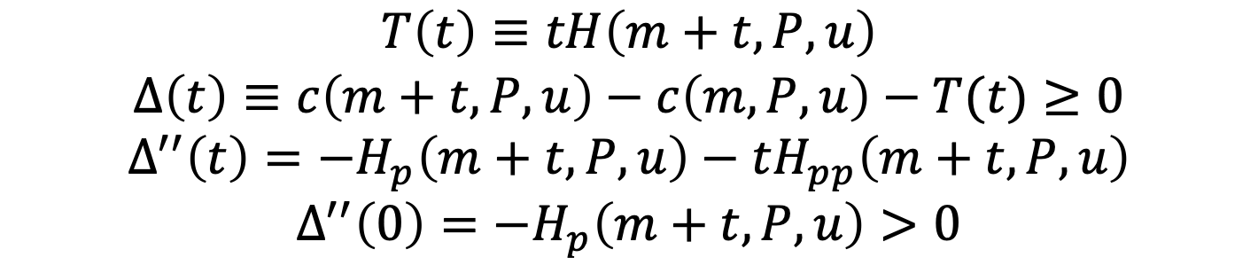
Properties of Excess Burden
$$T\left(t\right)≡tH\left(m+t,P,u\right)$$
$$Δ\left(t\right)≡c\left(m+t,P,u\right)−c\left(m,P,u\right)−T(t)≥0$$
$$Δ^{′′}\left(t\right)=−H_{p}\left(m+t,P,u\right)−tH_{pp}\left(m+t,P,u\right)$$
$$Δ^{′′}\left(0\right)=−H_{p}\left(m+t,P,u\right)>0$$
Excess burden is (usually) convex
  Tax smoothing; base broadening
  Beckerian theory of politics (QJE 1983)
E.g., linear demand

Slide 9


Figure 2. Excess burden with linear demand
$$Δ\left(t\right)$$
Market price reaches the choke price
$$t^{2}$$
0
t

Slide 10
Figure 3. Adapting to climate change
$$Δ\left(t\right)$$
0
Temperature

Slide 11

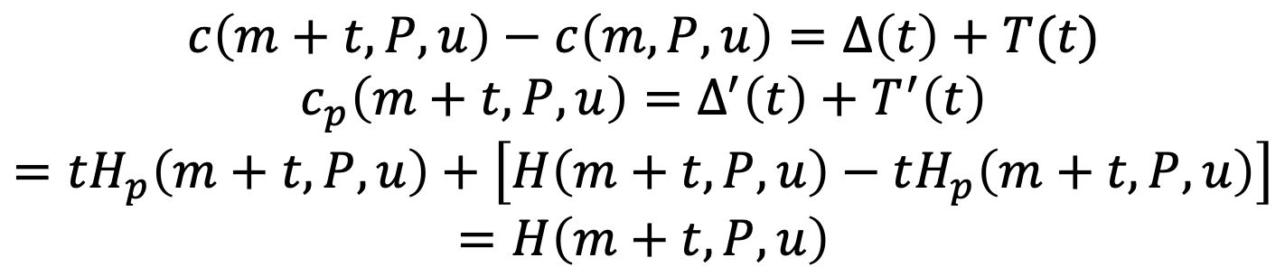
Costs and Their Composition
$$c\left(m+t,P,u\right)−c\left(m,P,u\right)=Δ\left(t\right)+T(t)$$
$$c_{p}\left(m+t,P,u\right)=Δ^{′}\left(t\right)+T^{′}\left(t\right)$$
$$=tH_{p}\left(m+t,P,u\right)+\left[H\left(m+t,P,u\right)−tH_{p}\left(m+t,P,u\right)\right]=H\left(m+t,P,u\right)$$
The degree to which behavior responds to price:
  is irrelevant for the amount of harm to a consumer (from dt > 0)
  but does determine its composition
Near t = 0, 100 percent of the harm is $T′$
Otherwise, 100 percent, or more, of the harm could be $Δ′$

Slide 12

The Excess Burden of Crime
Let H = hours at risk
  going outside at night
  walking alone
Let t = muggings per hour. T(t) = total muggings
More criminals: dt > 0
Potential victims take actions to protect themselves (i.e., spend less hours at risk, H_{p} < 0)
The cost of crime exceeds the number of muggings
Fewer muggings could indicate more crime ($T^{′}\left(t\right)<0$)
  But not in a safe neighborhood ($T^{′}\left(0\right)>0$)
$$c\left(m+t,P,u\right)−c\left(m,P,u\right)>Δ\left(t\right)$$

Slide 13

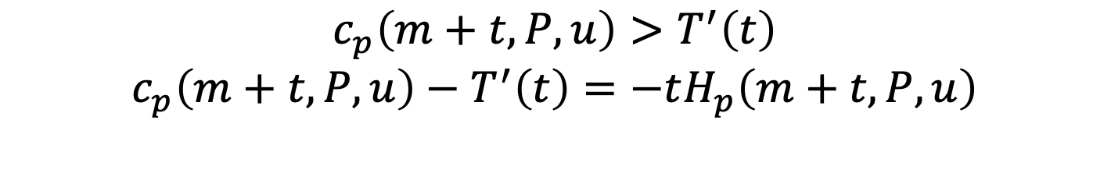
The Excess Burden of Disease
Let H = hours exposed to disease
Let t = hourly probability of catching disease and dying
Medical innovation: dt < 0
Potential victims take fewer actions to protect themselves (i.e., spend more hours at risk, H_{p} < 0)
The value of medical innovation exceeds the value of lives actually saved
Regardless of how much behavior responds, use hypothetical lives save to get innovation’s total value
  The composition of that value could be more than 100% $Δ′$
$$c_{p}\left(m+t,P,u\right)>T^{′}\left(t\right)$$
$$c_{p}\left(m+t,P,u\right)−T^{′}\left(t\right)=−tH_{p}\left(m+t,P,u\right)$$

Slide 14
Number of Deaths by Overdose involving Opioids
Wider naloxone distribution

Slide 15
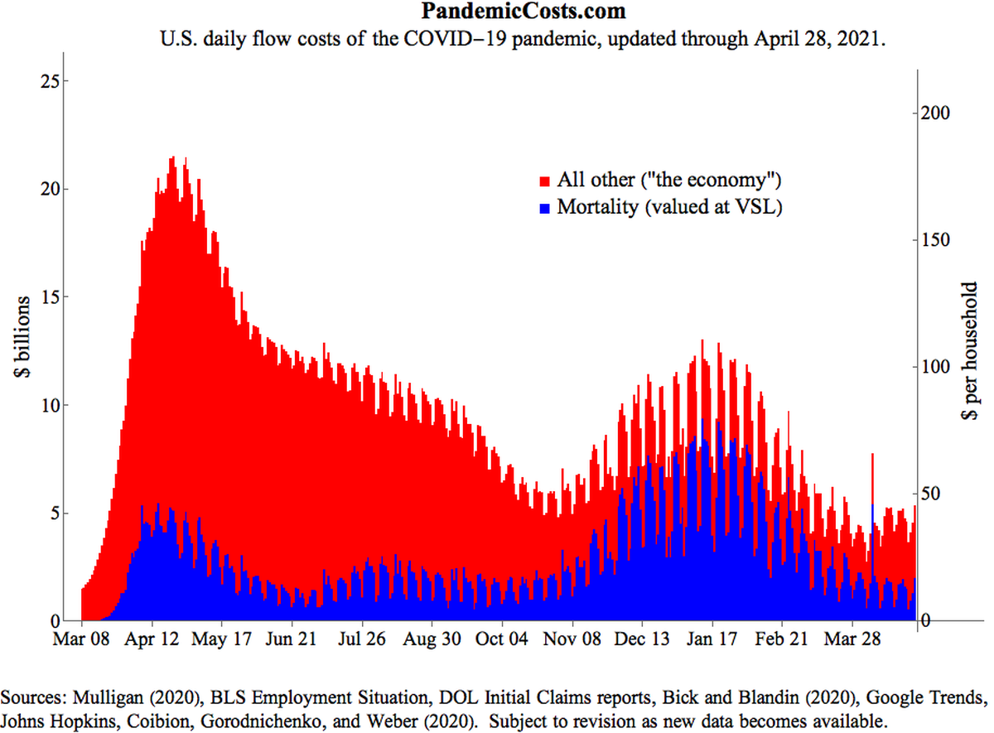


$$Δ\left(t\right)$$
$$T\left(t\right)$$
Guest Lecture by Casey B. Mulligan

Slide 16
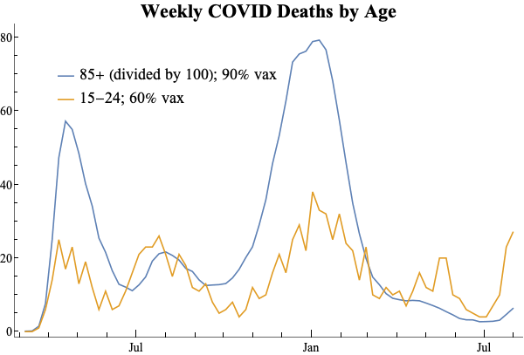

Slide 17


Figure 4. Excess burden of two taxes
p
A
$$m+t_{1}+t_{2}$$
$$T_{1}$$
$$T_{1}$$
Marginal cost
$$m$$
Quantity of taxed good
0

